Slide 1
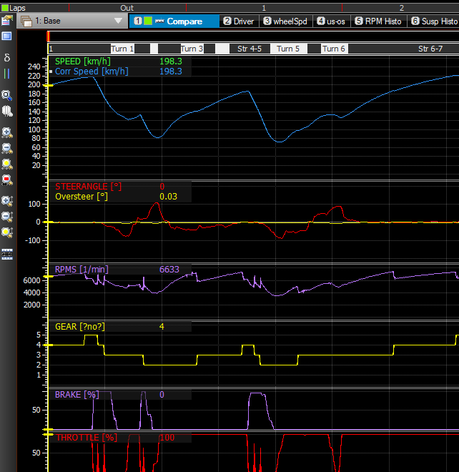
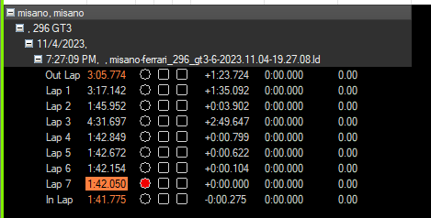
Sim-Racing Telemetry
Made and Modified by: Thomas Schendl
- This project creates a tool that shows Assetto Corsa Competizione telemetry data. Simply put in a lap time on any track and then immediately see data on acceleration, braking, understeer, oversteer, and suspension.

